Slide 1
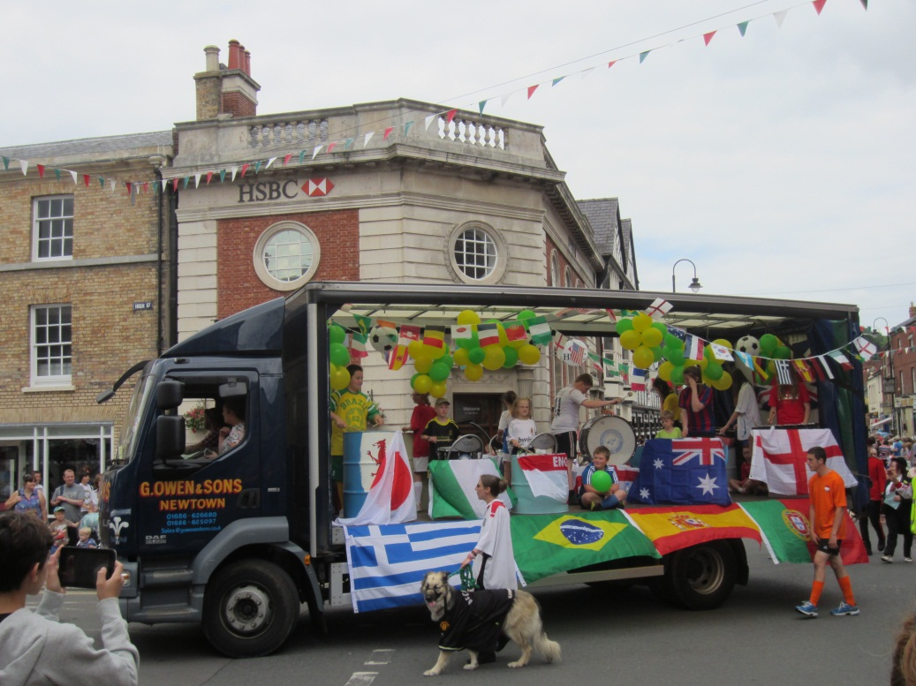
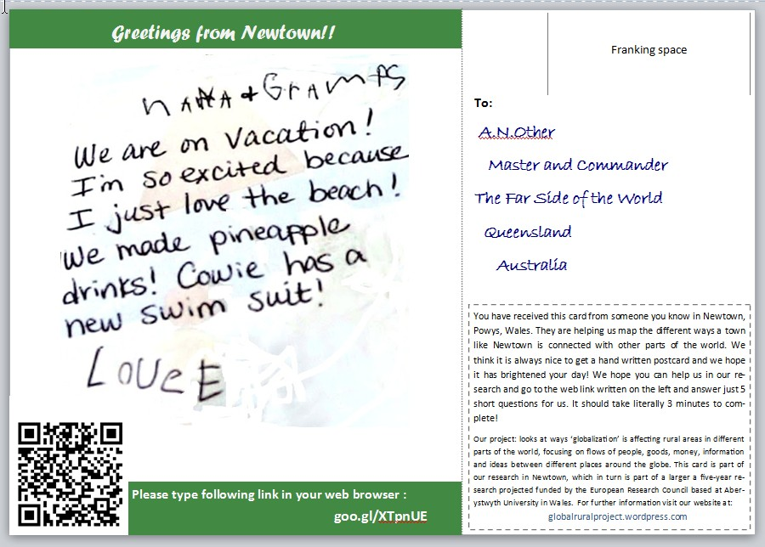
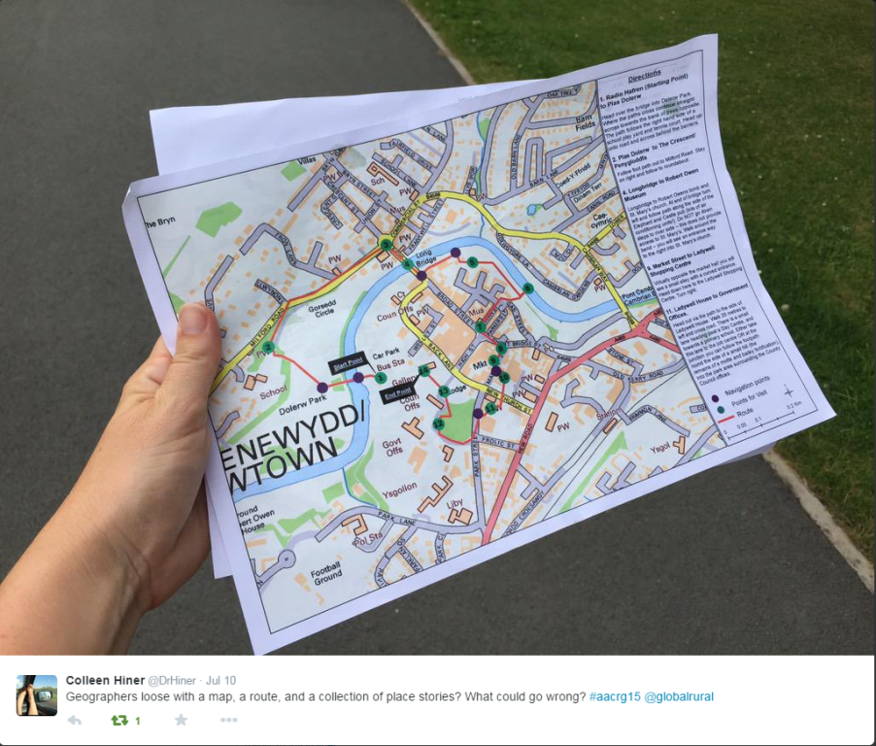
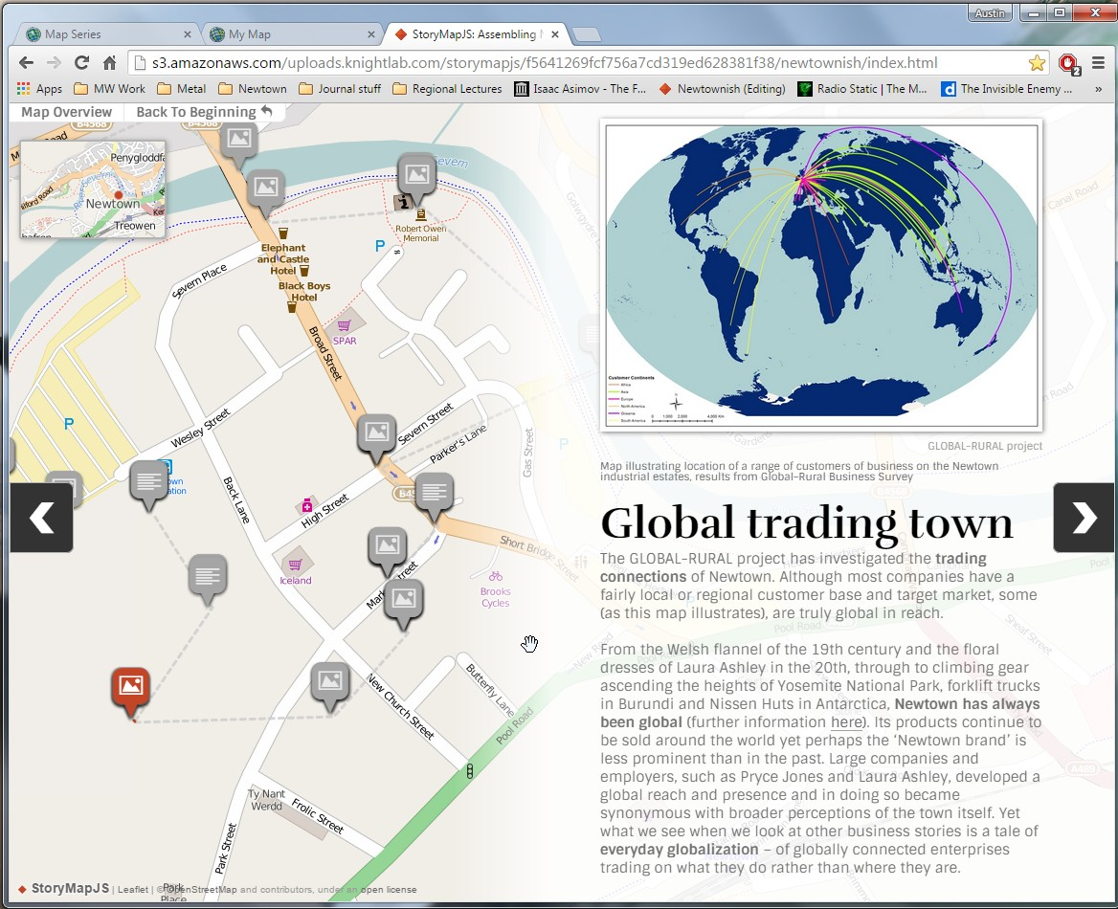
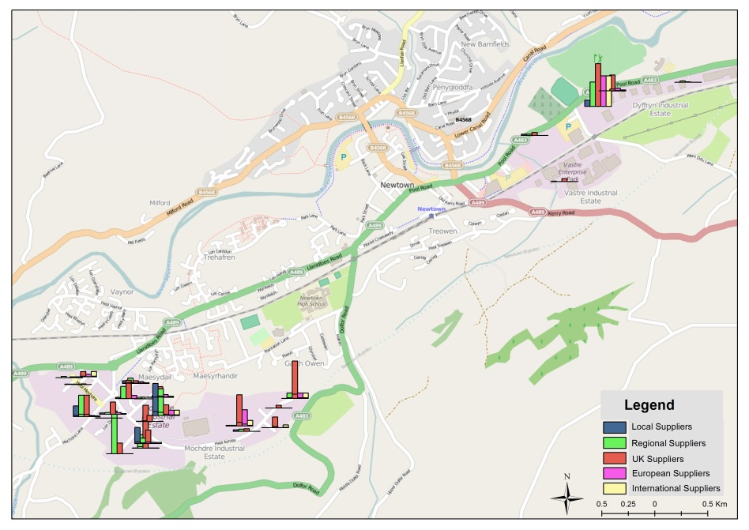
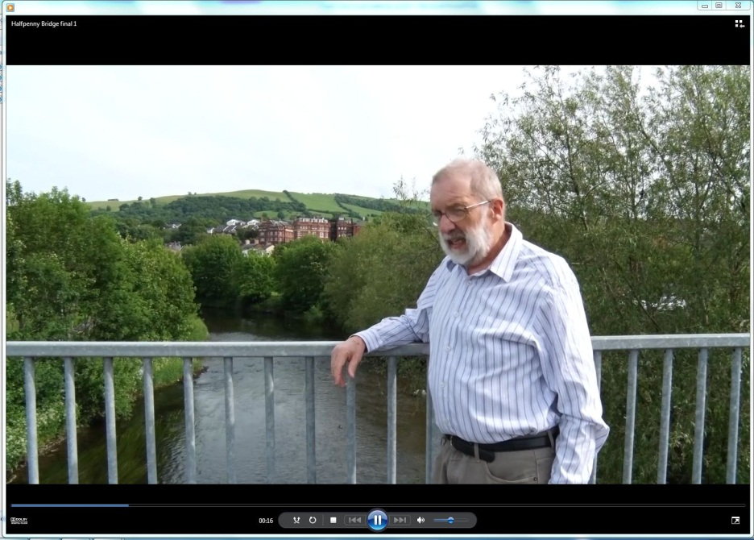
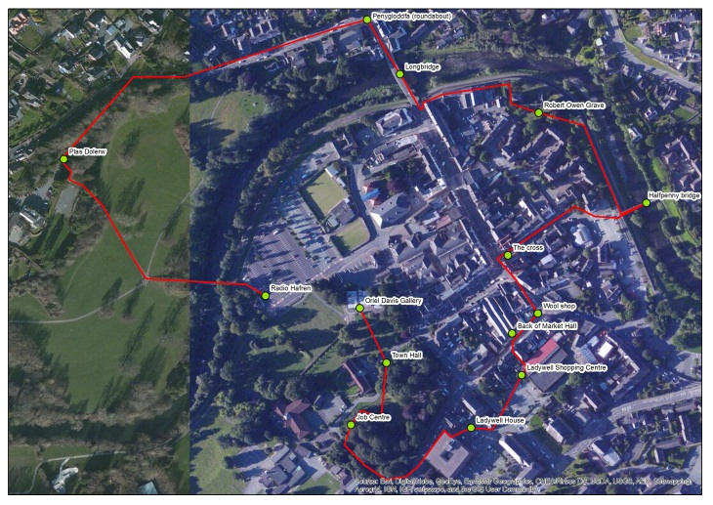
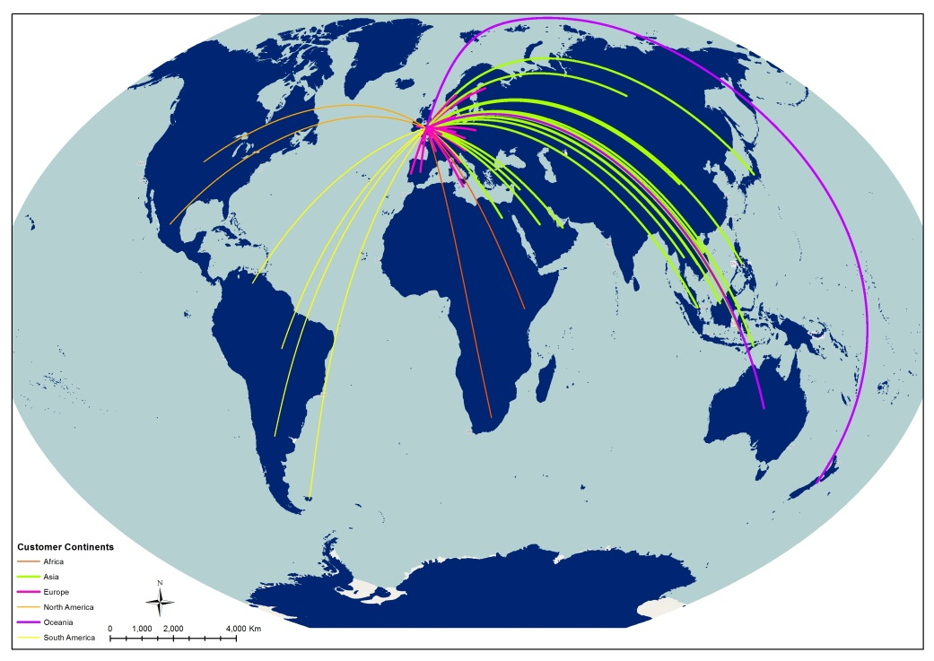
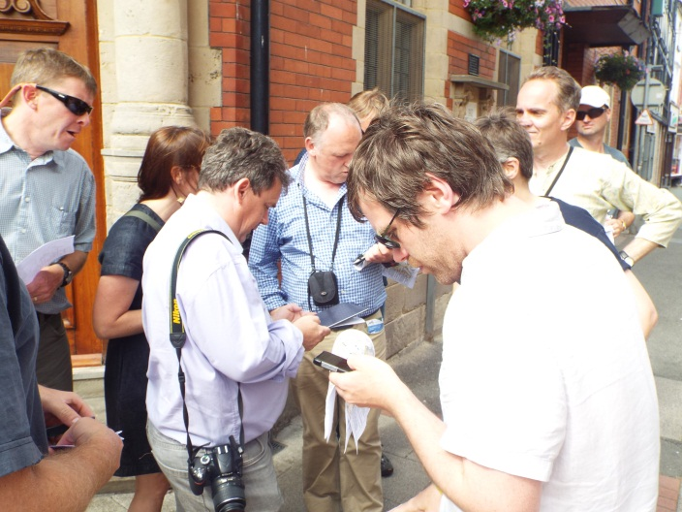
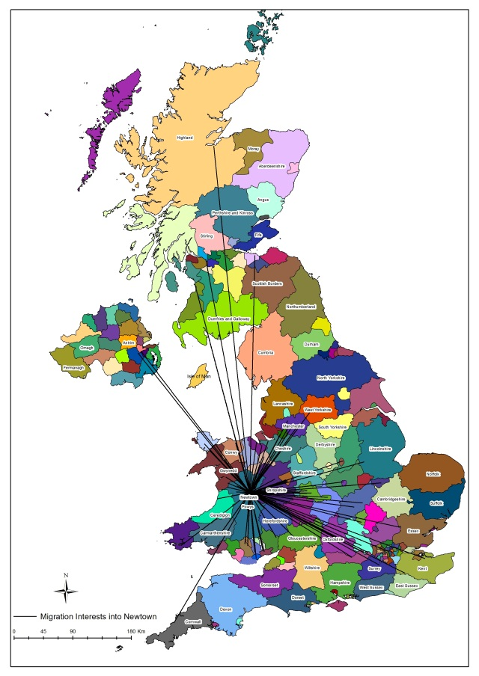
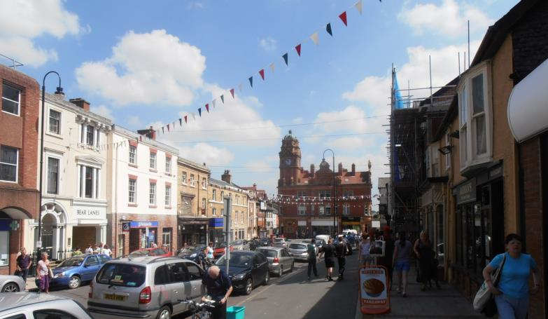
Exploring Everyday Globalization with Digital and Visual Methods
Michael Woods, Jesse Heley, Laura Jones, Anthonia Onyeahialam and Marc Welsh
Aberystwyth University
The Study
Research on globalization and its local impacts has tended to focus on high-profile examples that have been subject to significant and often dramatic pressures: global cities that are centres for transnational finance, commerce or culture, international tourism resorts, sites of large-scale economic investment or divestments, localities with large immigrant populations and so on. Yet, for most localities, experiences of globalization have been much more subtle, mundane and incremental. We call this ‘everyday globalization’ – changes in the food that we eat, the clothes we wear, the goods we buy, the companies we work for, the places we holiday, the entertainment we consume, the charitable causes we support, the ways in which we engage with friends and family who live elsewhere, and more. These aspects of globalization have been studied singularly in cultural studies and sociology, but they have rarely been examined in terms of their collective contribution in reshaping specific places.
As one part of the larger ERC GLOBAL-RURAL project we are exploring everyday globalization through an in-depth three-year case study of the small town of Newtown in rural Wales. As a town of around 10,000 people with a fairly homogenous population and an industrial base that has undergone significant economic restructuring in recent decades, Newtown has been selected as a unexceptional, ‘ordinary’ town where the impacts of globalization are implicit rather than explicit.
In framing the research we have drawn on Cindi Katz’s notion of ‘critical topography’ or ‘counter-topography’, which calls attention to the affinities and lines of association between places and the everyday experiences of people in a globalizing world; but which also rejects the imposition of top-down topographies of place and global networks.
Adopting a critical topographic approach has led us to rethink our methodology for the research, to try to avoid defining the positioning of Newtown in relation to globalization from above and instead to try to identify and trace networks and relations both within and beyond the town from the bottom up. As such, in addition to conventional methods such as interviews and questionnaire surveys, we are employing a range of more participatory and ethnographic methods, including visual and digital methods, that we hope will enable us to engage residents in talking about their experiences of globalization in an open and expansive way without pre-conceptions. This poster outlines some of the digital and visual methods that we are utilising as part of this approach.
As part of the European Research Council GLOBAL-RURAL project we are studying everyday globalization in the small town of Newtown. Using digital and visual methods helps us to capture data about people’s everyday interactions with global networks and experiences of change from the bottom-up.
Using Digital Methods
Digital methods are also important to us in expanding and enhancing our interaction with local residents. Digital methods not only provide flexible means of collecting data, but also allow rapid dissemination of results and consequently allow a more iterative process of engagement with residents in the town. Some of the digital methods that we are using include:
Online surveys and data collection – Platforms such as Qualtrics permit greater flexibility in collecting survey data, but also a greater geographical reach. One exercise involves school pupils sending a postcard to someone they know outside the town, with the recipient asked to complete an online survey about their contacts with Newtown.
Crowd-sourcing visual and other data – The study website has structured opportunities for people to submit their own photographs, videos and other data on the research themes and to comment and feedback on emerging research results and outputs.
Participatory and qualitative GIS – Participatory GIS techniques are being employed to map evidence of globalization in the town and people’s global networks, including combining maps with images, sound and commentaries. Qualitative GIS helps to visualize material from interviews and other qualitative data to provide accessible means of conveying findings to the public and stimulating further discussion.
Storymap – The Storymap app has been used to create an interactive tour of the town with commentary, images and video telling the history of Newtown’s global connections. As well as being a dissemination and public engagement method, the Storymap is being used for data collection, with questions prompting users to contribute their own memories and stories. The Storyapp walk was tested with participants in the 2015 Quadrennial UK-US-Canadian Rural Geography Conference.
Using Visual Methods
Visual methods are important to our research on everyday globalization as a means of overcoming the limitations of verbal data collection methods and the constraints of language. By using images to prompt discussion and by collecting data in visual form we are enabling respondents to express themselves and communicate information without worrying about finding the correct terminology. Some of the visual methods that we are using include:
Images and objects as prompts – photographs, postcards, maps and objects are used as prompts for discussion or stories in interviews and focus groups. Some prompts are more-than-visual, for example a ‘bring and share’ dinner to prompt discussion of encounters with international food.
Tactile surveys – for example, placing an extra-large world map in the shopping centre and asking people to put markers on countries they have visited. The visual collage created is a prompt for discussion about the globalization of travel.
Videos and visual ethnography – Videoing interviews in situ allows places and features to be shown not just described; filming community events etc can reveal embedded influences of everyday globalization.
Participant generated photography and videos – Participants are invited to submit their own photographs and videos, sometimes around structured exercises. One exercise invites residents to send us a ‘selfie’ from their holiday destination as a way of collecting data on international travel.
Some ethical and technical considerations
Expanding our research with visual and digital methods has generated new ethical and technical challenges. Technically, challenges emerge from the combining of mixed methods, and from the use of different technologies – some of which are dependent on wifi or mobile connections. The use of social media and online platforms for some exercises will create social biases in the self-selecting sample. At the same time, ethical challenges follow from the nature of some visual and digital methods, with issues around user-generate d data, the recording of informed consent, archiving, and the incompatibility of some methods with conventional anonymisation of participants. To address these challenges we are evaluating the ethical dimensions of individual exercises in turn and securing the appropriate permissions, developing mechanisms for obtaining informed consent tailored to each context, and working with research participants and gatekeepers in co-producing an understanding of the research ethics involved.
Overseas sales by businesses in Newtown (from business survey)
www.everydayglobalization.wordpress.com
@globalrural

